Slide 1

Experiential Learning Project Assessment-I on “Personal Expense Tracker” under the course Python Programming Language (N-PCCCM304P)
Presented By
Sinchan Abhishek Tambe
CM25054
Section A
Under the Guidance
of
Mrs. Mayuri Getme
Session:2026-27 (ODD )
Department of CSE(AI&ML)
S. B. JAIN INSTITUTE OF TECHNOLOGY MANAGEMENT AND RESEARCH,NAGPUR
An Autonomous Institute, Affiliated to RTMNU, Nagpur

Slide 2
Problem statement:
Personal Expense Tracker:
Develop a Python-based Personal Expense Tracker that helps users record, organize, and monitor their daily income and expenses. The application should allow users to add, view, update, and delete financial transactions, categorize expenses, calculate total income, total expenses, and current balance, and generate monthly or category-wise expense reports. The system should securely store financial records using file handling or a database and provide a simple, menu-driven interface for efficient personal finance management.
Objectives:
To design a menu-driven Python application for recording daily income and expenses.
To let users add, view, update, and delete financial transactions easily.
To categorize transactions (e.g. Food, Rent, Salary, Travel) for better organization.
To automatically calculate total income, total expenses, and current balance.
To generate monthly and category-wise reports for spending insights.
To ensure secure, persistent storage of records using file handling (CSV

Slide 3
Algorithm
Start the program.
1. Check whether there is an expenses file (expenses.csv). If not, create it and put in the column names: Date, Type, Category, Amount.
2. Show the main menu to the user, offering the choices: Add Transaction, View, Update, Delete, Reports, and Exit.
3. Get the choice from the user
4. If the choice is Add Transaction:
5. Ask for the date, type (either income or expense), category, and amount.
6. Check if the inputs are all valid, i.e., the date is in the correct format, the amount is a positive value, and the type can only be Income or Expense.
7. If any of the inputs is not valid, tell the user which input is wrong and ask for the right input.
8. Once the inputs have been checked and confirmed to be valid, store the inputs in the file and show the message "Transaction added successfully."
9. If the choice is View, Update, Delete, or Reports, give the message saying that the corresponding feature will be implemented in the future phase of the project.
10. If the choice is Exit, save all data and exit the program.
11. If the choice is not one of the menu items, show the error message and show the menu again.
12. Keep going back to step 3 to step 8 until exit.
13. End.

Slide 4
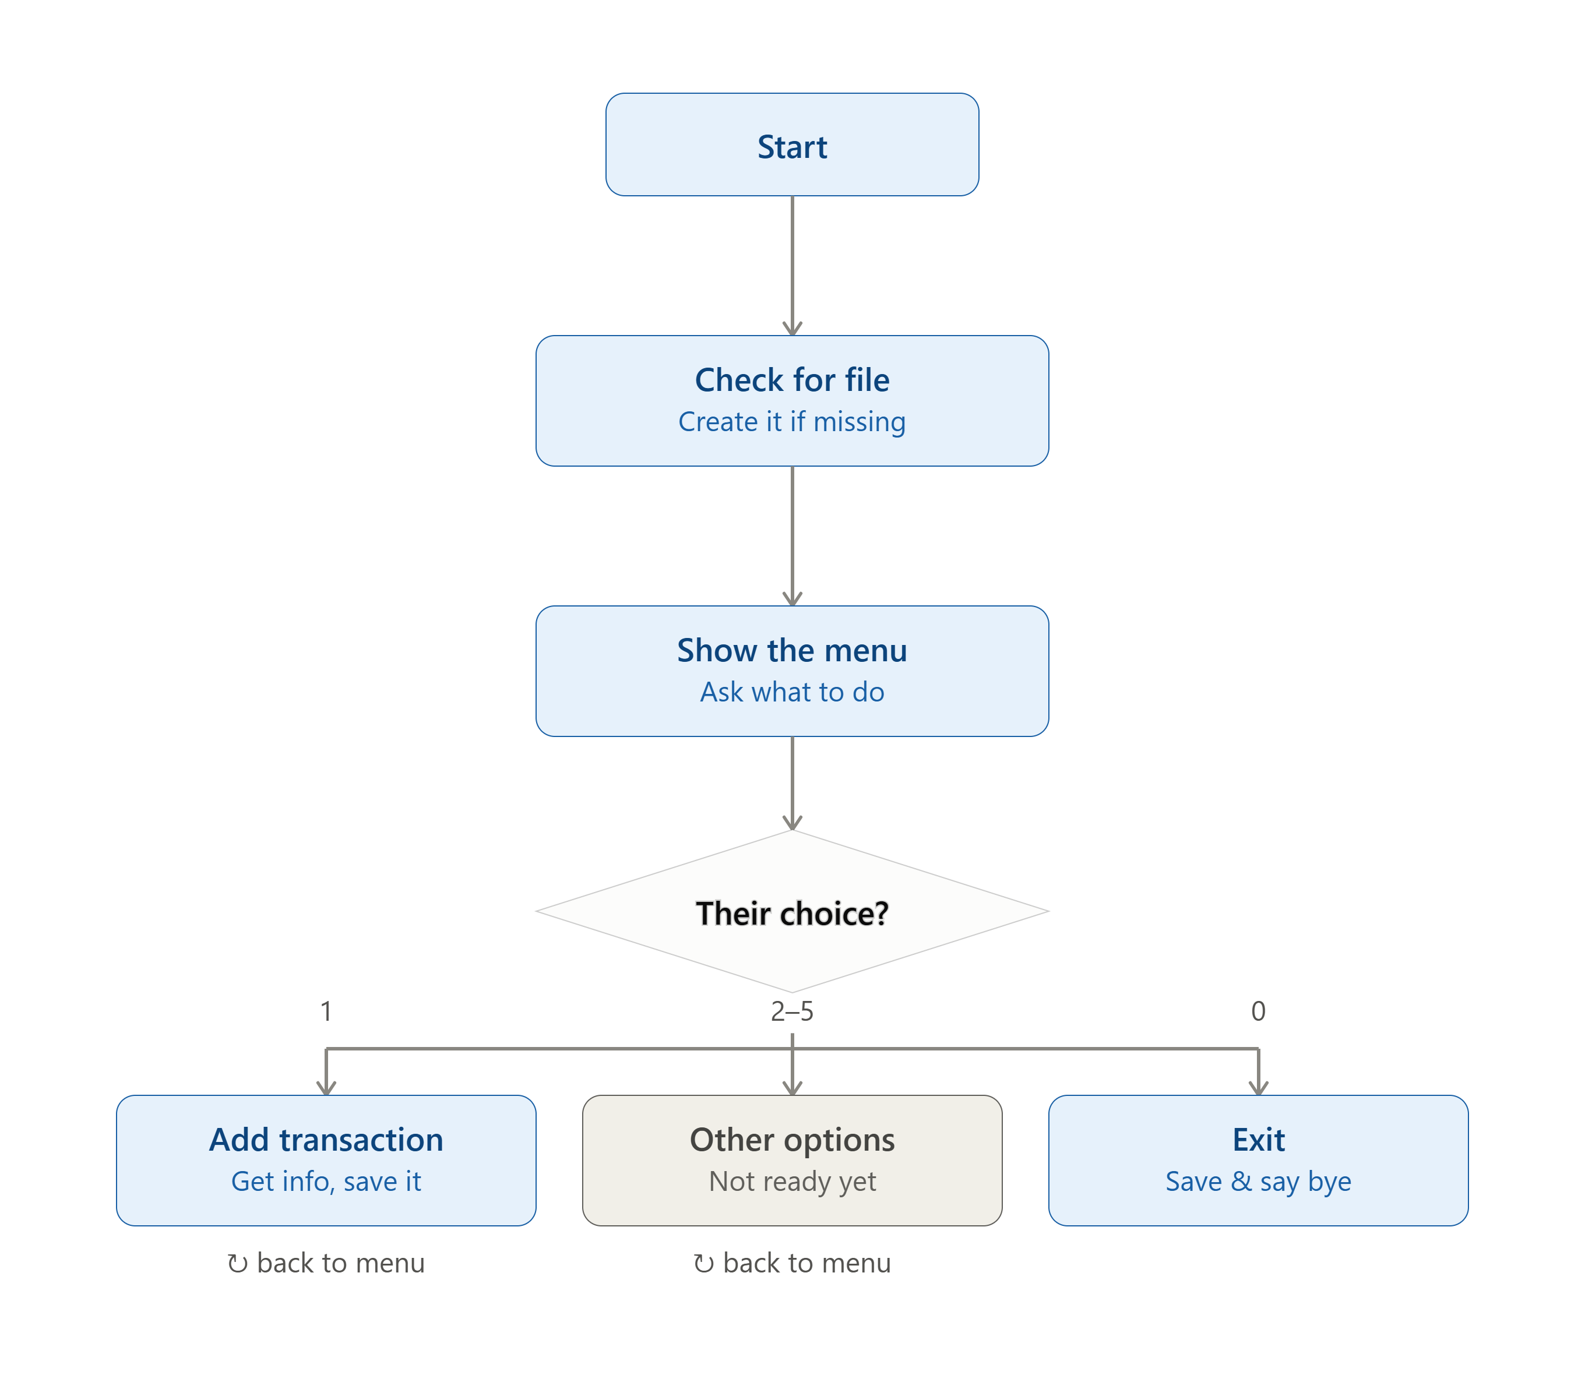
Flowchart/pseudocode

Slide 5
Understanding of Python logic
csv library — writes each transaction as a clean, structured row so the data can be read by Excel or Python itself.
os library — checks if expenses.csv already exists, so old data is never overwritten on restart.
Loop (while True) — keeps the menu running so the user can add multiple entries without restarting the program.
If-elif-else — decides what to do based on the user's menu choice and checks the entry type is valid.
Functions — the program is split into small tasks (add_transaction(), display_menu(), etc.), each doing one job.
Try-except — catches invalid input (like typing text instead of a number) so the program doesn't crash.
File handling (append mode) — adds new transactions to the end of the file without deleting existing ones.

Slide 6
GitHub — Repository, Commits & Contribution
Account & repository — created a personal GitHub account and a repository, personal-expense-tracker, “Python lab”.
Initial setup — added README.md (problem statement + objectives) and a .gitignore for Python.
Uploading code — pushed the Module 1 code (menu skeleton + working Add Transaction) as the first commit.
Meaningful commits — descriptive messages tracking real progress, e.g.:
"Add file initialization and menu skeleton"
"Implement Add Transaction with input validation"
Collaboration — added mentor/instructor as a repository collaborator for review and feedback.
Individual contribution — solo project: 100% of design, coding, testing, and documentation done independently.

Slide 7

S. B. Jain Institute of Technology Management and research

